Slide 1
Microsoft Dynamics AX 2012 Administration Workshop Chapter 7: Manage Batch Processing
Presenter Name
Presenter Title
Presenter Company

Slide 2
Conditions and Terms of Use
Microsoft Confidential
This training package is proprietary and confidential, and is intended only for uses described in the training materials. Content and software is provided to you under a Non-Disclosure Agreement and cannot be distributed. Copying or disclosing all or any portion of the content and/or software included in such packages is strictly prohibited.
The contents of this package are for informational and training purposes only and are provided "as is" without warranty of any kind, whether express or implied, including but not limited to the implied warranties of merchantability, fitness for a particular purpose, and non-infringement.
Training package content, including URLs and other Internet Web site references, is subject to change without notice. Because Microsoft must respond to changing market conditions, the content should not be interpreted to be a commitment on the part of Microsoft, and Microsoft cannot guarantee the accuracy of any information presented after the date of publication. Unless otherwise noted, the companies, organizations, products, domain names, e-mail addresses, logos, people, places, and events depicted herein are fictitious, and no association with any real company, organization, product, domain name, e-mail address, logo, person, place, or event is intended or should be inferred.
Copyright and Trademarks
© 2013 Microsoft Corporation. All rights reserved.
Microsoft may have patents, patent applications, trademarks, copyrights, or other intellectual property rights covering subject matter in this document. Except as expressly provided in written license agreement from Microsoft, the furnishing of this document does not give you any license to these patents, trademarks, copyrights, or other intellectual property.
Complying with all applicable copyright laws is the responsibility of the user. Without limiting the rights under copyright, no part of this document may be reproduced, stored in or introduced into a retrieval system, or transmitted in any form or by any means (electronic, mechanical, photocopying, recording, or otherwise), or for any purpose, without the express written permission of Microsoft Corporation.
For more information, see Use of Microsoft Copyrighted Content at http://www.microsoft.com/about/legal/permissions/
Microsoft® and Microsoft Dynamics® are either registered trademarks or trademarks of Microsoft Corporation in the United States and/or other countries. Other Microsoft products mentioned herein may be either registered trademarks or trademarks of Microsoft Corporation in the United States and/or other countries. All other trademarks are property of their respective owners.

Slide 3
Students: How to View this Presentation
Switch to Notes Page view
Click View on the ribbon and select Notes Page
Use page up or page down to navigate
Zoom in or out as needed
Most slides will have supporting text that you can view now or after the delivery
Add notes to your copy of the presentation if you want to
You take the presentation files home with you.

Slide 4
Objective
After completing this chapter, you will be able to:
Provide an overview of the batch server topology
Review and set up batch groups
Review and set up batch jobs and tasks
Review batch processing of dependent tasks
Review how to clean up batch tables

Slide 5
Introduction
This chapter describes how you can use batch processing to run specific tasks as batch jobs, which can be scheduled and run on a different computer (a batch server).
Many tasks in Microsoft Dynamics AX can be run as part of batch jobs.
Printing reports, performing maintenance, or sending electronic documents.
By using batch jobs, you can avoid slowing down your computer or the server during typical working hours.
Notes:
This chapter describes how you can use batch processing to run specific tasks as batch jobs, which can be scheduled and run on a different computer (a batch server). Many tasks in Microsoft Dynamics AX can be run as part of batch jobs. For example, batch jobs can include tasks for printing reports, performing maintenance, or sending electronic documents. By using batch jobs, you can avoid slowing down your computer or the server during typical working hours.
Most batch tasks can be run on a batch server, but some must be run on the client. Tasks that run on the server can run automatically as part of batch jobs, regardless of whether a client is open. However, tasks that run on the client must be run manually by using the Set up batch processing form.
The tasks in a batch job can run sequentially or at the same time. In addition, you can create dependencies between tasks. This means that you can set up a different sequence of tasks depending on whether an earlier task succeeds or fails.
Note: If a client task is marked Private, only the user who created that task can run it.

Slide 6
Batch Server Topology Planning
You can configure any active AOS as a batch server.
To create a dedicated batch server that does not act as an active AOS, you must put the batch server in a cluster separate from the AOS instances that accept client connections.
The batch capacity is based on the maximum number of threads that can run on the AOS, concurrently.
You can run multiple batch threads across multiple AOS servers.
Notes:
You can configure any active AOS as a batch server. To create a dedicated batch server that does not act as an active AOS, you must put the batch server in a cluster separate from the active AOS. You must also make sure that users are not connecting to this dedicated batch server.
The capacity of a batch server is determined based on the maximum number of threads that can run on the AOS, concurrently. Each thread executes one batch task. You can add complex dependencies between, or among, tasks. You can run these tasks in a serial steps or parallel steps, depending on the business logic and requirements. All tasks that do not have any dependencies are considered parallel tasks.
AOS instances that are configured as batch servers periodically check for tasks with a waiting status. For tasks waiting to be processed, the batch server assigns each parallel task to a thread and starts to process the thread.
You can run multiple threads across multiple AOS instances. Each AOS instance automatically runs multiple threads, depending on the capacity that is defined in the configuration settings. Therefore, parallel tasks from a job can execute on multiple threads across multiple AOS instances.
A batch server checks for available threads once a minute. Therefore, you might have to wait for a minute before you can see a waiting task being picked up for processing by an available thread.
Note: A dedicated load balancer cannot be configured as a batch server.

Slide 7
Batch Server Management Planning
All batch servers can be managed from a single location
An AOS should be excluded from batch processing when it is busy with regular transaction processing
Schedule batches so that the AOS is available for user traffic during the day and for batch traffic overnight
If the company has servers in different time zones, they can be set up to process batches during their off-hours
Notes:
All batch servers can be managed from a single location.
One common use of batch servers is to load balance jobs across multiple time zones and servers. You can define the time period during which an AOS acts as a batch server. You can also set the number of threads that the batch server will process during the time period. The applicable time is based on the user's time zone and not on the time zone of the location of the AOS. The time period is configured based on a schedule of start time and end time.
Because batch servers are also active AOS’s that service requests from Microsoft Dynamics AX clients and other Microsoft Dynamics AX components, determine carefully when an AOS is available to process batches.
For example, a batch server might be set to process only two batch threads from 8:00 to 6:00 P.M. in the time zone that it is located in. But from 6:00 P.M. to 7:30 A.M., it could be set to process 20 threads.

Slide 8
Batch Framework Definitions
Batch task
A batch-enabled class.
Batch job
A job contains 1 or more batch tasks that execute on the same schedule. You can define dependencies between tasks.
Batch group
Used to relate a batch job to 1 or more batch servers.
Batch threads
The batch scheduler assigns tasks to threads for processing.
Each batch server has 1 or more threads as defined in the batch schedule.
Batch server
AOS instance enabled for batch processing.
Batch schedule
Defines the timeframe when an AOS instance is available for batch processing. The number of threads can also be configured per timeframe.

Slide 9
Configure a Batch Server
Scenario
You want to set up a batch server to process sales orders that will be entered through AIF.
Procedure
System administration > Setup > System > Server configuration.
Set as batch server
Set batch threads
Set batch schedule
Notes:
The following are some points to consider about when each AOS can be available for batch processing:
An AOS should be excluded from batch processing when it is busy with regular transaction processing.
Schedule batches so that the AOS is available for user traffic during the day and for batch traffic overnight.
If the company has servers in different time zones, they can be set up to process batches during their off-hours.

Slide 10
Notes Continued
Notes:
Configure a Batch Server (continued)
Scenario: Configure a Batch Server
Gary, the Systems Implementer, wants to set up a batch server to process sales orders that will be entered through AIF.
Procedure: Configure an AOS as a Batch Server
In this procedure, you will configure an AOS as a batch server:
Open System administration > Setup > System > Server configuration.
Select Is batch server to enable batch processing on the server.
On the Batch server schedule FastTab, enter the maximum number of batch threads that can be run on the AOS instance at the same time. The server continues to collect threads from the queue until the maximum number is reached.
To specify the period when the server is available for batch processing, enter a starting time in the Start time field and an ending time in the End time field.
To specify an additional period, click Add, and then repeat step 4.
On the Batch server groups FastTab, use the arrow buttons to add or remove batch groups from the list of groups that can run on the selected server.
Note: A good rule of thumb is to set the maximum number of threads at 2-4 per processor core.
Note: If the server is running a task when its batch processing availability ends, the task continues to run until it is completed. However, the server does not collect more tasks from the queue.

Slide 11
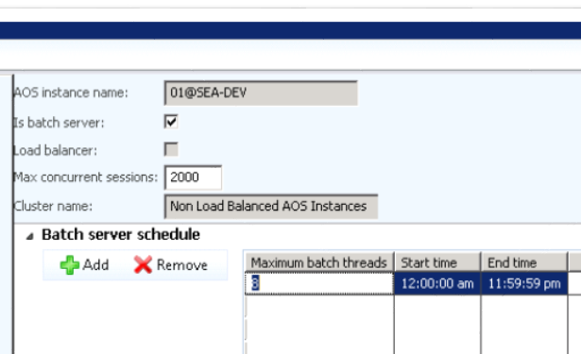

Configure a Batch Server
System administration > Setup > System > Server configuration.

Slide 12
Batch Groups
Used to group and run jobs on a specific batch server or group of batch servers.
Provides the ability to isolate one batch workload from another.
Notes:
Batch groups are used to group and run selected tasks on a specific batch server. Examples of batch groups include the following:
Jobs that run on a specific computer
Jobs that require many resources
Jobs that belong to a specific module
Jobs that run at certain intervals; for example, every night, every week, or every month
When the batch process is started, the jobs and reports in the batch group are run according to the start date, start time, and recurrence parameters specified on the individual jobs.
Note: To run client tasks manually, they must be assigned to batch groups in the Set up batch processing form.

Slide 13
Batch Group Impact on Job Concurrency
What impact can batch group configuration have on batch job concurrency? Let’s take a look…
Optimizing AX Batch Performance - Batch Group Configuration http://blogs.msdn.com/b/axinthefield/archive/2011/03/25/optimizing-ax-batch-performance-using-batch-group-configurations.aspx

Slide 14
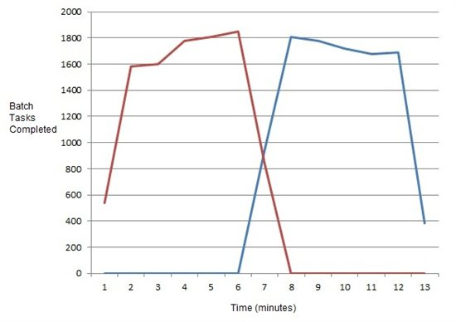
Batch Processing: Invoicing Scenario 1
Two invoicing jobs in the same batch group
Two batch servers are assigned to the batch group
Notes:
In this example, both jobs are sharing a pool of 16 batch threads. One batch job monopolizes all threads until it completes. Then the other job starts using the available threads.

Slide 15
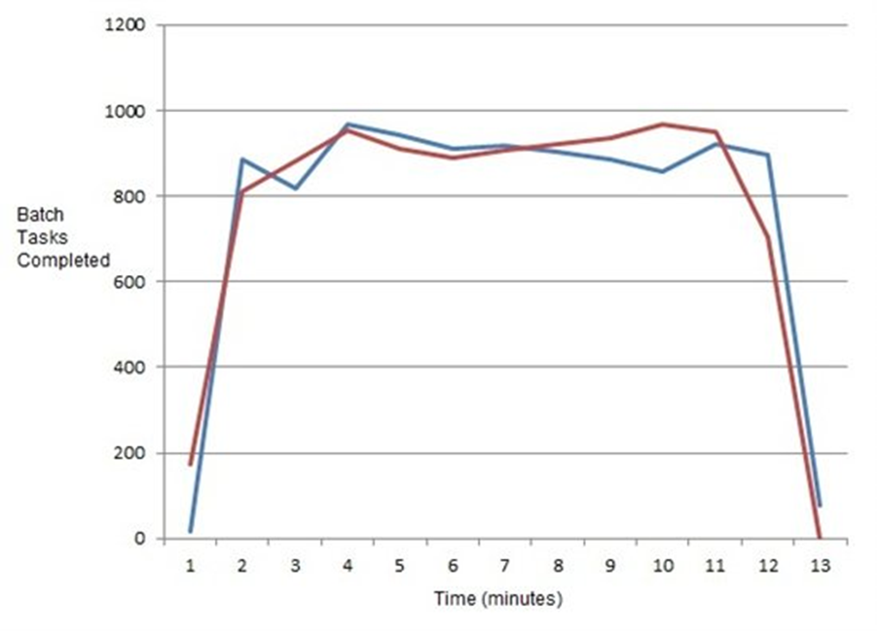
Batch Processing: Invoicing Scenario 2
Two invoicing jobs in separate batch groups
Each batch group has 1 batch server
Notes:
In this example, each batch group has just 8 threads and resources aren’t shared. The jobs run, in parallel, starting and completing at about the same time.

Slide 16
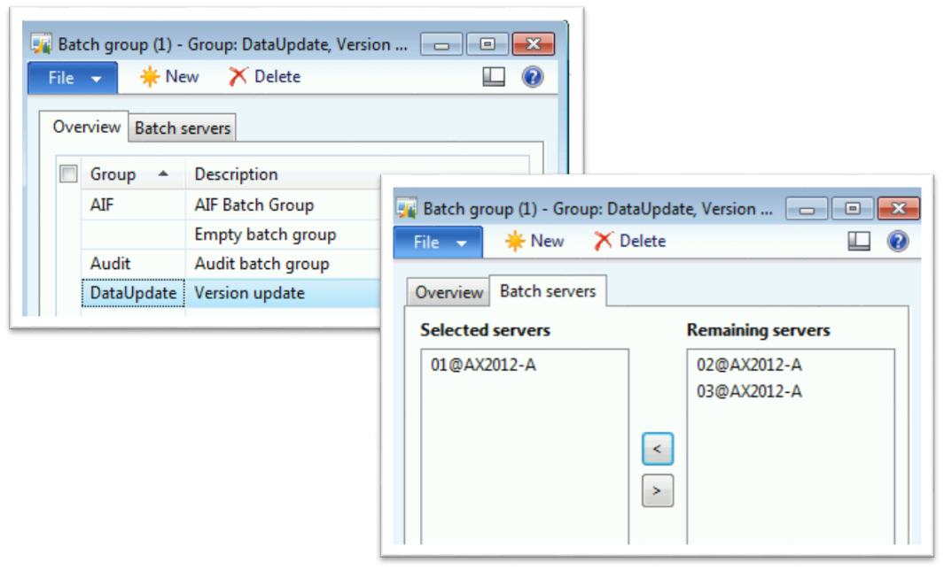
Create a Batch Group
Procedure:
Administration > Setup > Batch groups
Notes:
Procedure: Create Batch Group
In this procedure, you will create a batch group that will be used to create Sales orders through AIF and assign this batch group to run on a specific server.
Go to Administration > Setup > Batch groups.
Create a new batch group.
In the Group field, enter the identification for the batch group, such as “AIF”.
In the Description field, type a name for the batch group.
Select the Batch servers tab.
Move the server 01@AX2012-A from “Remaining servers” to “Selected servers”.
Click Close.

Slide 17
Batch Jobs
A group of tasks that are submitted to an AOS instance for automatic processing.
Dependencies can be created between tasks in a job.
Batch jobs run with the security credentials of the user who created the job.
Users cannot create batch jobs to run tasks they are not allowed to run in the Microsoft Dynamics AX client.

Slide 18
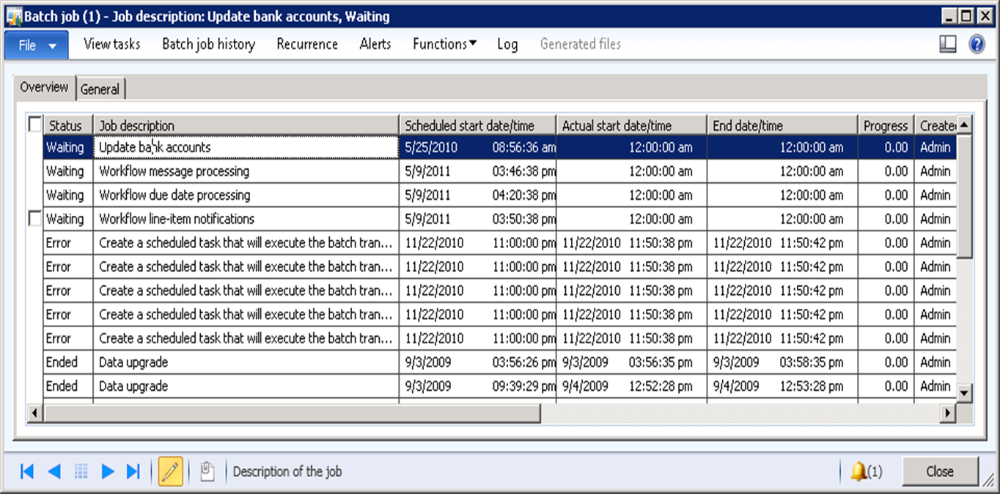
Create a Batch Job
Procedure
System administration > Inquiries > Batch job
Notes:
A batch job is a group of tasks that are submitted to an AOS instance for automatic processing. Dependencies can be created between tasks. This means that tasks can be set up in a sequence so that the next task in a sequence will run, or not run, depending on whether an earlier task succeeds or fails.
As a security precaution, batch jobs run with the security credentials of the user who created the job. Then users cannot create batch jobs to run tasks that they are not allowed to run in the Microsoft Dynamics AX program.
Procedure: Create Batch job
In this procedure, you will create a batch job that brings the Sales orders into the AIF queue for processing.
Open System administration > Inquiries > Batch job.
Create a new batch job with job description of “Aif batch job”.
In the Scheduled start date/time field, enter the date and time that the batch job will run. If a date and time is not entered, the current date and time will set automatically.
Press CTRL+S to save the job.
(Optional) To set up a recurring job, click the Recurrence button and enter a range and pattern for the recurrence.
(Optional) To set up an alert for the batch job, click the Alerts button and select the alert options.
To activate the batch job to be executed, it must be in the Waiting status. To update the status click Functions > Change status, and then click Waiting.
When you are finished, close the form.
Note: The tasks in a batch job can run sequentially or at the same time.

Slide 19
Batch Tasks
Batch tasks are added to a batch job.
Single-threaded tasks (classes) always use only a single batch thread regardless of how many are available. All processing is serial for this type of task.
Multi-threaded tasks (classes) will use all available threads to process the workload, in parallel, based on the batch group configuration. Invoicing and AIF inbound processing are examples.
Notes:
Batch tasks are added to a batch job. Administrators can also configure batch servers to run multiple threads with each thread performing a task. All batch tasks that are waiting can be processed by any available server that is configured as a batch server.
For more information on optimizing batch processing, see the following blogs:
http://blogs.msdn.com/b/axinthefield/archive/2011/03/25/optimizing-ax-batch-performance-using-batch-group-configurations.aspx
http://blogs.msdn.com/b/axinthefield/archive/2011/06/13/optimizing-ax-batch-performance-batch-thread-configuration.aspx
Important: For optimal performance, it is recommended to put long running Batch jobs/tasks in their own Batch groups.

Slide 20
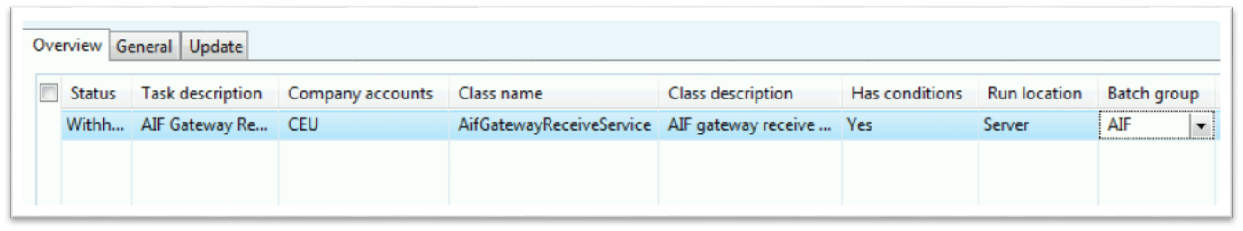
Add Batch Tasks to a Job
Procedure
System administration > Inquiries > Batch jobs > View tasks
Notes:
Procedure: Add a Task to a Batch Job
In this procedure, you will add the necessary tasks to the batch job that will bring the Sales orders into the AIF queue for processing.
In the Batch jobs form, select the “AIF batch job” job and click the View tasks button.
Press CTRL+N to create four new tasks.
Task description = AIF Gateway Receive.
Company accounts = CEU.
Class name = AifGatewayReceiveService.
Select the “AIF” batch group for the task.
(Optional) To make the selected task dependent on another task in the job, click in the Has conditions grid, and follow these steps.
Press CTRL+N to create a new condition.
Select the task ID of the parent task.
Select the status that the parent task must reach before the dependent task can run.
(Optional) If you have entered more than one condition, and if all conditions must be met before the dependent task can run, select a Condition type of All. Select a Condition type of Any if the dependent task can run after any of the conditions have been met.
(Optional) Choose how to handle task failures. To ignore the failure of a specific task, on the General tab, mark the Ignore task failure option for that task. If this option is marked, the failure of the task will not cause the job to fail. You can also use the Maximum retries field to specify the number of times that a task should be retried before it is considered to have failed.
Note: The tasks in a batch job can run sequentially or at the same time.

Slide 21
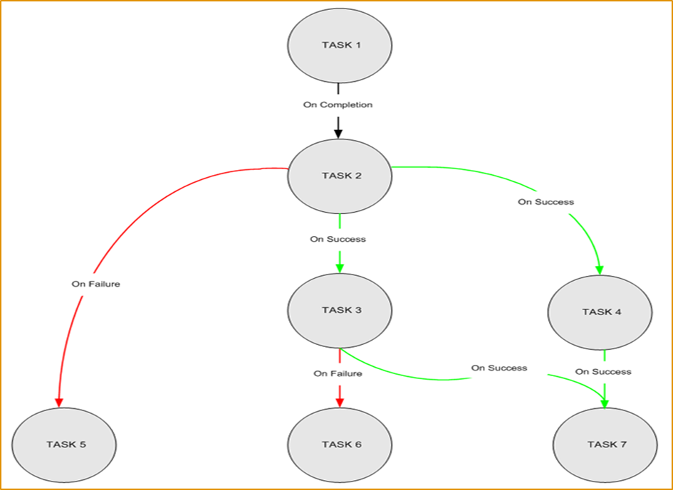
Batch Processing of Dependent Tasks
Batch tasks can be dependent on other tasks
Notes:
Consider that you have created a job that is called JOB 1. As shown in the figure on the slide above, the job has seven tasks: TASK 1, TASK 2, TASK 3, TASK 4, TASK 5, TASK 6, and TASK 7.
The dependencies of your tasks are as follows:
TASK 1 is the first task
TASK 2 runs on completion of TASK 1 (regardless of the success or failure of TASK 1)
TASK 3 runs on success of TASK 2
TASK 4 runs on success of TASK 2
TASK 5 runs on failure of TASK 2
TASK 6 runs on failure of TASK 3
TASK 7 runs on success of both TASK 3 and TASK 4
Let us assume that two batch servers, Batch1 and Batch2, are configured with a capacity of one thread each. Batch1 checks for waiting tasks, assigns TASK 1 to its thread, and starts execution. Although Batch2 is also available with one thread, TASK 2 will keep waiting until TASK 1 has completed successfully.
As soon as TASK 1 has completed successfully, TASK 2 is ready for execution. Let us assume this time that Batch2 checks for waiting tasks, assigns TASK 2 to its thread, and starts execution of TASK 2. If TASK 2 is successful, TASK 3 and TASK 4 are awaiting execution. Let us assume that Batch2 checks for waiting tasks, assigns TASK 3 to its thread, and starts execution. Batch1 also checks for waiting tasks, assigns TASK 4 to its thread, and starts execution. If TASK 3 and TASK 4 are completed successfully, one of the batch servers will execute TASK 7.
If TASK 2 fails, one of the batch servers will execute TASK 5. If TASK 3 fails, one of the available batch servers will execute TASK 6.

Slide 22
Client and Private Tasks
Batch jobs contain tasks that are designated to run on either the client computer or the server computer.
Tasks that run on the server can run automatically as part of batch jobs, regardless of whether a client is running.
However, tasks that run on the client must be run manually by using the Set up batch processing form.
Client jobs may be marked as private. Because they run on the client, private jobs are not run automatically and can be run only by the user who scheduled them.

Slide 23
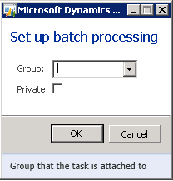
Client and Private Tasks
Procedure
Organization administration > Periodic > Batch processing
Notes:
Procedure: Run Client and Private Batch Tasks
Batch jobs contain tasks that are designated to run on either the client computer or the server computer. Tasks that run on the server can run automatically as part of batch jobs, regardless of whether a client is running. However, tasks that run on the client must be run manually by using the Set up batch processing form.
Client jobs may be marked as private. Because they run on the client, private jobs are not run automatically and can be run only by the user who scheduled them.
To run client and private batch jobs, follow these steps:
Open Organization administration > Periodic > Batch processing.
Select the batch group that the client tasks belong to.
Note: The tasks in a batch job can run sequentially or at the same time.

Slide 24
Deleting Batch Jobs
It is good practice to periodically delete old Batch job data from the BATCH, BATCHJOB, BATCHHISTORY, and BATCHJOBHISTORY tables:
System administration > Inquiries > Batch job > Delete
System administration > Inquiries > Batch job history > Delete
Notes:
Over time, it may be necessary to delete batch table information as the information is no longer needed.
This will delete from the BATCH and BATCHJOB tables:
System administration>Inquiries>Batch job>Delete
This will delete from the BATCHHISTORY and BATCHJOBHISTORY tables:
System administration>Inquiries>Batch job history>Delete

Slide 25
Test Your Knowledge
The class will complete this section

Slide 26
Chapter Review
Fill in the blanks to test your knowledge of batch processing.
Used to combine and run selected tasks on a specific batch server. _____
A group of tasks that are submitted to an AOS instance for automatic processing. _____
The computer where batch jobs are executed. _____
The ____ in a batch job can run sequentially or simultaneously.
Use this to set up frequency and duration of batch jobs. _____
Use this to set up notifications about batch jobs. _____

Slide 27
Chapter Review (Answers)
Fill in the blanks to test your knowledge of batch processing.
Used to combine and run selected jobs on a specific batch server. Batch Group
A group of tasks that are submitted to an AOS instance for automatic processing. Batch Job
The computer where batch jobs are executed. Batch Server
The Tasks in a batch job can run sequentially or simultaneously.
Use this to set up frequency and duration of batch jobs. Batch Schedule
Use this to set up notifications about batch jobs. Alerts

Slide 28
Chapter Summary
In this chapter, we discussed the following topics:
Batch server topology
Batch groups, jobs, and tasks
Batch processing of dependent tasks
Cleaning up batch tables

